Slide 1
XD12R + FPGA (XC24R) 단품 Control Jig board
2026. 02. 26
㈜ 글로벌테크놀로지

Slide 2
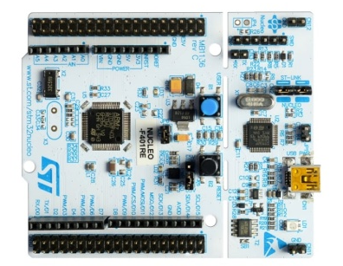

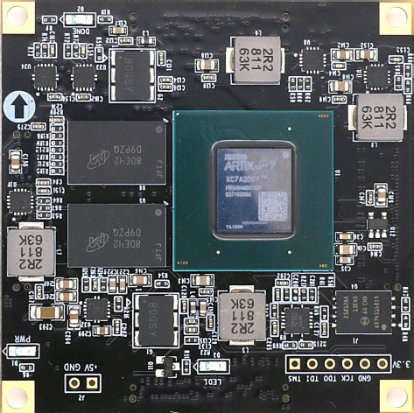
Hardware 구성 (기존)
PC
ⓒ
MCU
board
(STM32F446
NUCLEO)
전원: 5V
(3.3V내부연결)
SPI,
MCLK, VSYNC, INTx2, I2C
TEST
Control Jig Board
ⓐ
XC24R
#1
주문제작
Socket
PC
RS232
LED display (R,G,B chip)
Module
36 channels
Gate 1,2,3
DIO1 ~ 24
SPI, Int x 2, I2c x 1,
MCLK, VSYNC, GPIO
PA0~15, (13,14 제외)
PB0~10, PB13~15, PH0,1
MUX control
SVO1 ~ 12
ⓑ
DATA&SV
MUX
DIO
FPGA Board ALINX AC7A200
(ARTIX XC7A200T), 전원 : 5V
ⓔ
DIO
XD12R
#1
주문제작
Socket
DIO
XD12R
#2
상용
Socket
XD12R
#3
상용
Socket
ⓓ
DIO1 ~ 24
SV
SV
SV
SVO1 ~ 12
IC 부품
DAC :
AD7392 Analog Device, 12bits
AD5340 Analog Device 12bits
DAC8541, TI, 16bits
Gate 1,2,3
ⓔ
LED_ON/OFF
Mux
VLED
Feed back
(FBO1, 2, 3)
Gate 1,2,3
Analog Switch (SPDT) :
- NLASB3157, ONSEMI
Analog Switch :
- TMUX1308QDYYRQ1, TI P-delay 15ns
12bits
Parallel
SEL
ⓕ
FB Mux Switch
Power Switch Module(시분할)
- Gate Driver
& FET
DAC x 3
DAC
DAC
DAC
Feed back
(FBO1, 2, 3)
Feed back
(FBO1, 2, 3)
VLED R,G,B
RGB LED Power DC/DC, Input : 12V,
VLED : 6V or 9V or 12V
Power Module
DC/DC
Input : 12V
Output : 5V, 3.3V, 1.8V
Control Switch & LED Indication
Notes:
SPI Port 확인

Slide 3
Hardware 구성 (변경)
PC
ⓒ
MCU
board
(STM32F446
NUCLEO)
전원: 5V
(3.3V내부연결)
Serial Out
Serial In
SVSYNC
Control Jig Board
TIM1 (PA8)
ⓐ
XD12R
주문제작
Socket
SVO
Frequency
Measure
Pin. 13
PC
TIM2 (PB3)
RS232
TIM3 (PC6)
O1
Current Measure
.
.
.
.
.
.
Channel Selection
TEST (V)
ADC (PB0)
Pin. 17
O12
SPI, nINT x 4
MCLK, VSYNC, FLLSYNC
UART
LED display (R,G,B chip)
Module
36 channels
ⓑ
FPGA Board ALINX AC7A200
(ARTIX XC7A200T), 전원 : 5V
ⓓ
DIO
XD12R
#1
상용
Socket
DIO
XD12R
#2
상용
Socket
DIO
XD12R
#3
상용
Socket
SV
Gate 1,2,3
SV
SV
VLED
12bits
Parallel
ⓕ
IC 부품
DAC :
AD7392 Analog Device, 12bits
AD5340 Analog Device 12bits
DAC8541, TI, 16bits
Power Switch Module(시분할)
- Gate Driver
& FET
DAC x 3
Feed back
(FBO1, 2, 3)
DAC
DAC
DAC
Feed back
(FBO1, 2, 3)
VLED R,G,B
RGB LED Power DC/DC, Input : 12V,
VLED : 6V or 9V or 12V
Power Module
DC/DC
Input : 12V
Output : 5V, 3.3V, 1.8V
Control Switch & LED Indication
Notes:
SPI Port 확인

Slide 4
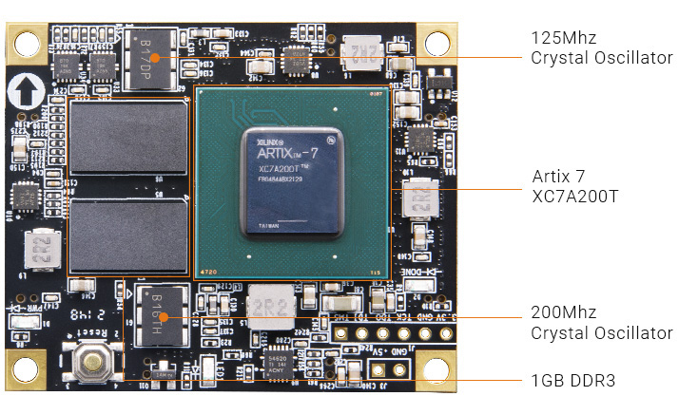
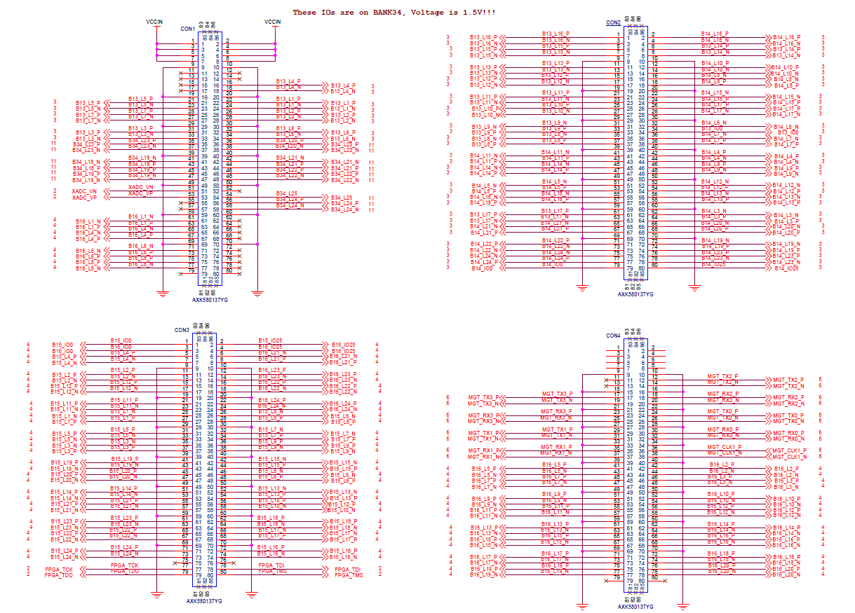
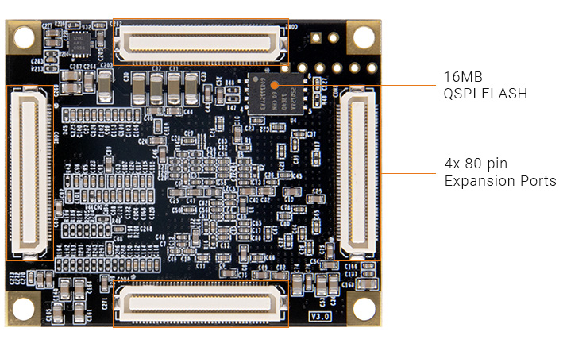
ⓓ FPGA Module
2025.12.15 update
ALINX AC7200
Board to Board Socket
Control Jig Board 에 적용 부품
Board to Board Header
- Panasonic AXK680337YG

Slide 5
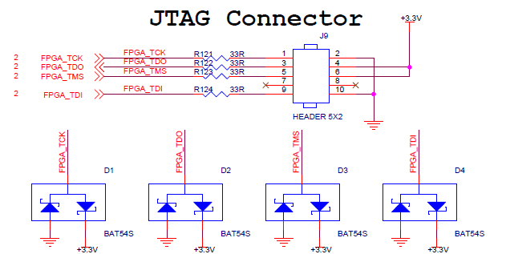
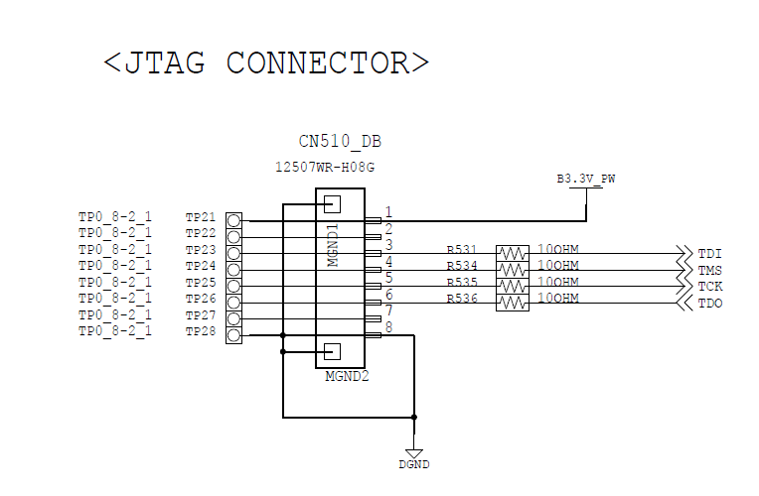
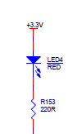
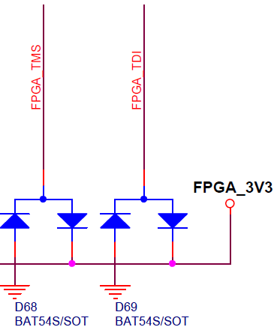
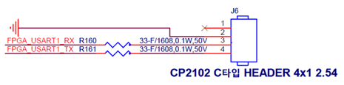
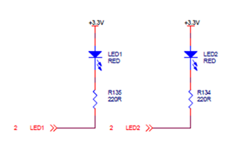
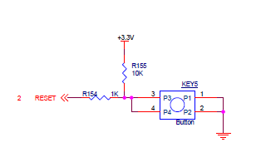
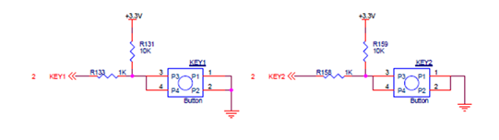
ⓓ FPGA Module – FPGA JTAG, UART Connector, Control Switch, LED Indication
12507WR-H08G
3.3V 전원 상태
LED10
RED
RESET Switch
LED1
GREEN
LED2
GREEN

Slide 6
FPGA 검증방안
MCU
MCLK
Vsync
FLL Vsync
XC24R
chip
DAC 신호와 Gate 신호는
Chip/FPGA 간에 선택출력
SPI
XDR
chip
INTn
Driving
Signals :
D1~24
SVO1~12
12bit
XC24R
FPGA
DAC1
MCU 는 command 와
관련된 신호를 chip 과
FPGA 에 모두 제공.
검증대상을 선택하는 S/W
설정을 MCU 가 출력.
(혹은 수동으로 전체 S/W 선택)
DAC2
외부
XDR
Conn.
DAC3
BNC : 측정용
Termination
TV pannel / BAR 연결

Slide 7
ⓓ FPGA Module – Connector Pin description (CON1)
PIN | FPGA board Net name | FPGA PIN | FPGA I/O Config | Main board Net name | I/O | 연결 |  | PIN | FPGA board Net Name | FPGA Pin | FPGA I/O Config | Main board Net name | I/O | 연결
PIN1 | VCCIN | - | +5V |  |  |  |  | PIN2 | VCCIN | - | +5V
PIN3 | VCCIN | - | +5V |  |  |  |  | PIN4 | VCCIN | - | +5V
PIN5 | VCCIN | - | +5V |  |  |  |  | PIN6 | VCCIN | - | +5V
PIN7 | VCCIN | - | +5V |  |  |  |  | PIN8 | VCCIN | - | +5V
PIN9 | GND | - | Ground |  |  |  |  | PIN10 | GND | - | Ground
PIN11 | NC | - |  |  |  |  |  | PIN12 | NC | -
PIN13 | NC | - |  |  |  |  |  | PIN14 | NC | -
PIN15 | NC | - |  |  |  |  |  | PIN16 | B13_L4_P | AA15
PIN17 | NC | - |  |  |  |  |  | PIN18 | B13_L4_N | AB15
PIN19 | GND | - | Ground |  |  |  |  | PIN20 | GND | - | Ground
PIN21 | B13_L5_P | Y13 | O_inter_sig_P[13] | O_inter_sig_P[13] | OUT |  |  | PIN22 | B13_L1_P | Y16 | O_inter_sig_P[12] | O_inter_sig_P[12] | OUT
PIN23 | B13_L5_N | AA14 | O_inter_sig_P[11] | O_inter_sig_P[11] | OUT |  |  | PIN24 | B13_L1_N | AA16 | O_inter_sig_P[10] | O_inter_sig_P[10] | OUT
PIN25 | B13_L7_P | AB11 | O_inter_sig_P[9] | O_inter_sig_P[9] | OUT |  |  | PIN26 | B13_L2_P | AB16 | O_inter_sig_P[8] | O_inter_sig_P[8] | OUT
PIN27 | B13_L7_P | AB12 | O_inter_sig_P[7] | O_inter_sig_P[7] | OUT |  |  | PIN28 | B13_L2_N | AB17 | O_inter_sig_P[6] | O_inter_sig_P[6] | OUT
PIN29 | GND | - | Ground |  |  |  |  | PIN30 | GND | - | Ground
PIN31 | B13_L3_P | AA13 | O_inter_sig_P[5] | O_inter_sig_P[5] | OUT |  |  | PIN32 | B13_L6_P | W14 | O_inter_sig_P[4] | O_inter_sig_P[4] | OUT
PIN33 | B13_L3_N | AB13 | O_inter_sig_P[3] | O_inter_sig_P[3] | OUT |  |  | PIN34 | B13_L6_N | Y14 | O_inter_sig_P[2] | O_inter_sig_P[2] | OUT
PIN35 | B34_L23_P | Y8 | 사용불가, 1.5V |  |  |  |  | PIN36 | B34_L20_P | AB7 | 사용불가, 1.5V
PIN37 | B34_L23_N | Y7 | 사용불가, 1.5V |  |  |  |  | PIN38 | B34_L20_N | AB6 | 사용불가, 1.5V
PIN39 | GND | - | Ground |  |  |  |  | PIN40 | GND | - | Ground
PIN41 | B34_L18_N | AA6 | 사용불가, 1.5V |  |  |  |  | PIN42 | B34_L21_N | V8 | 사용불가, 1.5V
PIN43 | B34_L18_P | Y6 | 사용불가, 1.5V |  |  |  |  | PIN44 | B34_L21_P | V9 | 사용불가, 1.5V
PIN45 | B34_L19_P | V7 | 사용불가, 1.5V |  |  |  |  | PIN46 | B34_L22_P | AA8 | 사용불가, 1.5V
PIN47 | B34_L19_N | W7 | 사용불가, 1.5V |  |  |  |  | PIN48 | B34_L22_N | AB8 | 사용불가, 1.5V
PIN49 | GND | - | Ground |  |  |  |  | PIN50 | GND | - | Ground
PIN51 | XADC_VN | M9 | Analog |  |  |  |  | PIN52 | NC
PIN53 | XADC_VP | L10 | Analog |  |  |  |  | PIN54 | B34_L25 | U7 | 사용불가
PIN55 | NC | - | NC |  |  |  |  | PIN56 | B34_L24_P | W9 | 사용불가
PIN57 | NC | - | NC |  |  |  |  | PIN58 | B34_L24_N | Y9 | 사용불가
PIN59 | GND | - | Ground |  |  |  |  | PIN60 | GND | - | Ground
PIN61 | B16_L1_N | F14 | O_inter_sig_P[1] | O_inter_sig_P[1] | OUT |  |  | PIN62 | NC | - | NC
PIN63 | B16_L1_P | F13 | O_inter_sig_P[0] | O_inter_sig_P[0] | OUT |  |  | PIN64 | NC | - | NC
PIN65 | B16_L4_N | E14 | O_inter_sig_N[31] | O_inter_sig_N[31] | OUT |  |  | PIN66 | NC | - | NC
PIN67 | B16_L4_P | E13 | O_inter_sig_N[30] | O_inter_sig_N[30] | OUT |  |  | PIN68 | NC | - | NC
PIN69 | GND | - | Ground |  |  |  |  | PIN70 | GND | - | Ground
PIN71 | B16_L6_N | D15 | O_inter_sig_N[29] | O_inter_sig_N[29] | OUT |  |  | PIN72 | NC | - | NC
PIN73 | B16_L6_P | D14 | O_inter_sig_N[28] | O_inter_sig_N[28] | OUT |  |  | PIN74 | NC | - | NC
PIN75 | B16_L8_P | C13 | O_inter_sig_N[27] | O_inter_sig_N[27] | OUT |  |  | PIN76 | NC | - | NC
PIN77 | B16_L8_N | B13 | O_inter_sig_N[26] | O_inter_sig_N[26] | OUT |  |  | PIN78 | NC | - | NC
PIN79 | NC | - | NC |  |  |  |  | PIN80 | NC | - | NC

Slide 8
ⓓ FPGA Module – Connector Pin description (CON2)
PIN | FPGA board Net name | FPGA PIN | FPGA I/O Config | Main board Net name | I/O | 연결 |  | PIN | FPGA board Net Name | FPGA Pin | FPGA I/O Config | Main board Net name | I/O | 연결
PIN1 | B13_L16_P | W15 | DAC_0[11] |  | OUT | DAC |  | PIN2 | B14_L16_P | V17 | DAC_0[10] |  | OUT | DAC
PIN3 | B13_L16_N | W16 | DAC_0[9] |  | OUT | DAC |  | PIN4 | B14_L16_N | W17 | DAC_0[8] |  | OUT | DAC
PIN5 | B13_L15_P | T14 | DAC_0[7] |  | OUT | DAC |  | PIN6 | B13_L14_P | U15 | DAC_0[6] |  | OUT | DAC
PIN7 | B13_L15_N | T15 | DAC_0[5] |  | OUT | DAC |  | PIN8 | B13_L14_N | V15 | DAC_0[4] |  | OUT | DAC
PIN9 | GND | - |  |  |  |  |  | PIN10 | GND | -
PIN11 | B13_L13_P | V13 | DAC_0[3] |  | OUT | DAC |  | PIN12 | B14_L10_P | AB21 | DAC_0[2] |  | OUT | DAC
PIN13 | B13_L13_N | V14 | DAC_0[1] |  | OUT | DAC |  | PIN14 | B14_L10_N | AB22 | DAC_0[0] |  | OUT | DAC
PIN15 | B13_L12_P | W11 | DAC_1[11] |  | OUT | DAC |  | PIN16 | B14_L8_N | AA21 | DAC_1[10] |  | OUT | DAC
PIN17 | B13_L12_N | W12 | DAC_1[9] |  | OUT | DAC |  | PIN18 | B14_L8_P | AA20 | DAC_1[8] |  | OUT | DAC
PIN19 | GND | - |  |  |  |  |  | PIN20 | GND | -
PIN21 | B13_L11_P | Y11 | DAC_1[7] |  | OUT | DAC |  | PIN22 | B14_L15_N | AB20 | DAC_1[6] |  | OUT | DAC
PIN23 | B13_L11_N | Y12 | DAC_1[5] |  | OUT | DAC |  | PIN24 | B14_L15_P | AA19 | DAC_1[4] |  | OUT | DAC
PIN25 | B13_L10_P | V10 | DAC_1[3] |  | OUT | DAC |  | PIN26 | B14_L17_P | AA18 | DAC_1[2] |  | OUT | DAC
PIN27 | B13_L10_N | W10 | DAC_1[1] |  | OUT | DAC |  | PIN28 | B14_L17_N | AB18 | DAC_1[0] |  | OUT | DAC
PIN29 | GND | - |  |  |  |  |  | PIN30 | GND | -
PIN31 | B13_L9_N | AA11 | DAC_2[11] |  | OUT | DAC |  | PIN32 | B14_L6_N | T20 | DAC_2[10] |  | OUT | DAC
PIN33 | B13_L9_P | AA10 | DAC_2[9] |  | OUT | DAC |  | PIN34 | B13_IO0 | Y17 | DAC_2[8] |  | OUT | DAC
PIN35 | B13_L8_N | AB10 | DAC_2[7] |  | OUT | DAC |  | PIN36 | B14_L7_N | W22 | DAC_2[6] |  | OUT | DAC
PIN37 | B13_L8_P | AA9 | DAC_2[5] |  | OUT | DAC |  | PIN38 | B14_L7_P | W21 | DAC_2[4] |  | OUT | DAC
PIN39 | GND | - |  |  |  |  |  | PIN40 | GND | -
PIN41 | B14_L11_N | V20 | DAC_2[3] |  | OUT | DAC |  | PIN42 | B14_L4_P | T21 | DAC_2[2] |  | OUT | DAC
PIN43 | B14_L11_P | U20 | DAC_2[1] |  | OUT | DAC |  | PIN44 | B14_L4_N | U21 | DAC_2[0] |  | OUT | DAC
PIN45 | B14_L14_N | V19 | IO_CH[23] |  | INOUT | DATA&SV MUX |  | PIN46 | B14_L9_P | Y21 | IO_CH[22] |  | INOUT | DATA&SV MUX
PIN47 | B14_L14_P | V18 | IO_CH[21] |  | INOUT | DATA&SV MUX |  | PIN48 | B14_L9_N | Y22 | IO_CH[20] |  | INOUT | DATA&SV MUX
PIN49 | GND | - |  |  |  |  |  | PIN50 | GND | -
PIN51 | B14_L5_N | R19 | IO_CH[19] |  | INOUT | DATA&SV MUX |  | PIN52 | B14_L12_N | W20 | IO_CH[18] |  | INOUT | DATA&SV MUX
PIN53 | B14_L5_P | P19 | IO_CH[17] |  | INOUT | DATA&SV MUX |  | PIN54 | B14_L12_P | W19 | IO_CH[16] |  | INOUT | DATA&SV MUX
PIN55 | B14_L18_N | U18 | IO_CH[15] |  | INOUT | DATA&SV MUX |  | PIN56 | B14_L13_N | Y19 | IO_CH[14] |  | INOUT | DATA&SV MUX
PIN57 | B14_L18_P | U17 | IO_CH[13] |  | INOUT | DATA&SV MUX |  | PIN58 | B14_L13_P | Y18 | IO_CH[12] |  | INOUT | DATA&SV MUX
PIN59 | GND | - |  |  |  |  |  | PIN60 | GND | -
PIN61 | B13_L17_P | T16 | IO_CH[11] |  | INOUT | DATA&SV MUX |  | PIN62 | B14_L3_N | V22 | IO_CH[10] |  | INOUT | DATA&SV MUX
PIN63 | B13_L17_N | U16 | IO_CH[9] |  | INOUT | DATA&SV MUX |  | PIN64 | B14_L3_P | U22 | IO_CH[8] |  | INOUT | DATA&SV MUX
PIN65 | B14_L21_N | P17 | IO_CH[7] |  | INOUT | DATA&SV MUX |  | PIN66 | B14_L20_N | T18 | IO_CH[6] |  | INOUT | DATA&SV MUX
PIN67 | B14_L21_P | N17 | IO_CH[5] |  | INOUT | DATA&SV MUX |  | PIN68 | B14_L20_P | R18 | IO_CH[4] |  | INOUT | DATA&SV MUX
PIN69 | GND | - |  |  |  |  |  | PIN70 | GND | -
PIN71 | B14_L22_P | P15 | IO_CH[3] |  | INOUT | DATA&SV MUX |  | PIN72 | B14_L19_N | R14 | IO_CH[2] |  | INOUT | DATA&SV MUX
PIN73 | B14_L22_N | R16 | IO_CH[1] |  | INOUT | DATA&SV MUX |  | PIN74 | B14_L19_P | P14 | IO_CH[0] |  | INOUT | DATA&SV MUX
PIN75 | B14_L24_N | R17 | I_FBI1 |  | IN | MCU / |  | PIN76 | B14_L23_P | N13 | I_FBI2 |  | IN | MCU /
PIN77 | B14_L24_P | P16 | I_FBI3 |  | IN | MCU / |  | PIN78 | B14_L23_N | N14 | I_FLLSYNC |  | IN | MCU
PIN79 | B14_IO0 | P20 | O_SPI_MISO |  | OUT | MCU |  | PIN80 | B14_IO25 | N15

Slide 9
ⓓ FPGA Module – Connector Pin description (CON3)
PIN | FPGA board Net name | FPGA PIN | FPGA I/O Config | Main board Net name | I/O | 연결 |  | PIN | FPGA board Net Name | FPGA Pin | FPGA I/O Config | Main board Net name | I/O | 연결
PIN1 | B15_IO0 | J16 | O_SVO1 |  | OUT | DATA&SV MUX |  | PIN2 | B15_IO25 | M17 | O_SVO2 |  | OUT | DATA&SV MUX
PIN3 | B16_IO0 | F15 | O_SVO3 |  | OUT | DATA&SV MUX |  | PIN4 | B16_IO25 | F21 | O_SVO4 |  | OUT | DATA&SV MUX
PIN5 | B15_L4_P | G17 | O_SVO5 |  | OUT | DATA&SV MUX |  | PIN6 | B16_L21_N | A21 | O_SVO6 |  | OUT | DATA&SV MUX
PIN7 | B15_L4_N | G18 | O_SVO7 |  | OUT | DATA&SV MUX |  | PIN8 | B16_L21_P | B21 | O_SVO8 |  | OUT | DATA&SV MUX
PIN9 | GND | - |  |  |  |  |  | PIN10 | GND | -
PIN11 | B15_L2_P | G15 | O_SVO9 |  | OUT | DATA&SV MUX |  | PIN12 | B16_L23_P | E21 | O_SVO10 |  | OUT | DATA&SV MUX
PIN13 | B15_L2_N | G16 | O_SVO11 |  | OUT | DATA&SV MUX |  | PIN14 | B16_L23_N | D21 | O_SVO12 |  | OUT | DATA&SV MUX
PIN15 | B15_L12_P | J19 | O_FB1 |  | OUT | FB Mux Switch |  | PIN16 | B16_L22_P | E22 | O_FB2 |  | OUT | FB Mux Switch
PIN17 | B15_L12_N | H19 | O_FB3 |  | OUT | FB Mux Switch |  | PIN18 | B16_L22_N | D22 | O_GATE1 |  | OUT | LED_ON/OFF_MUX
PIN19 | GND | - |  |  |  |  |  | PIN20 | GND | -
PIN21 | B15_L11_P | J20 | O_GATE2 |  | OUT | LED_ON/OFF_MUX |  | PIN22 | B16_L24_P | G21 | O_GATE3 |  | OUT | LED_ON/OFF_MUX
PIN23 | B15_L11_N | J21 | O_INT_FAULT |  | OUT | MCU |  | PIN24 | B16_L24_N | G22 | O_INT_LD |  | OUT | MCU
PIN25 | B15_L1_N | G13 |  |  |  |  |  | PIN26 | B15_L8_N | G20
PIN27 | B15_L1_P | H13 | I_SPI_CLK |  | IN | MCU |  | PIN28 | B15_L8_P | H20 | I_SPI_CS |  | IN | MCU
PIN29 | GND | - |  |  |  |  |  | PIN30 | GND | -
PIN31 | B15_L5_P | J15 | I_SPI_MOSI |  | IN | MCU |  | PIN32 | B15_L7_N | H22 | I_TEST |  | IN | Pull down
PIN33 | B15_L5_N | H15 | I_VSYNC |  | IN | MCU |  | PIN34 | B15_L7_P | J22 | DAC_0_clk |  | OUT | DAC
PIN35 | B15_L3_N | H14 | DAC_1_clk |  | OUT | DAC |  | PIN36 | B15_L9_P | K21 | DAC_2_clk |  | OUT | DAC
PIN37 | B15_L3_P | J14 | conn_in_N[5] |  | IN |  |  | PIN38 | B15_L9_N | K22 | conn_in_N[4] |  | IN
PIN39 | GND | - |  |  |  |  |  | PIN40 | GND | -
PIN41 | B15_L19_P | K13 | conn_in_N[3] |  | IN |  |  | PIN42 | B15_L15_N | M22 | conn_in_N[2] |  | IN
PIN43 | B15_L19_N | K14 | conn_in_N[1] |  | IN |  |  | PIN44 | B15_L15_P | N22 | conn_in_N[0] |  | IN
PIN45 | B15_L20_P | M13 | conn_in_P[5] |  | IN |  |  | PIN46 | B15_L6_N | H18 | conn_in_P[4] |  | IN
PIN47 | B15_L20_N | L13 | conn_in_P[3] |  | IN |  |  | PIN48 | B15_L6_P | H17 | conn_in_P[2] |  | IN
PIN49 | GND | - |  |  |  |  |  | PIN50 | GND | -
PIN51 | B15_L14_P | L19 | conn_in_P[1] |  | IN |  |  | PIN52 | B15_L13_N | K19 | conn_in_P[0] |  | IN
PIN53 | B15_L14_N | L20 | O_inter_sig_P[31] |  | OUT |  |  | PIN54 | B15_L13_P | K18 | O_inter_sig_P[30] |  | OUT
PIN55 | B15_L21_P | K17 | O_inter_sig_P[29] |  | OUT |  |  | PIN56 | B15_L10_P | M21 | O_inter_sig_P[28] |  | OUT
PIN57 | B15_L21_N | J17 | O_inter_sig_P[27] |  | OUT |  |  | PIN58 | B15_L10_N | L21 | O_inter_sig_P[26] |  | OUT
PIN59 | GND | - |  |  |  |  |  | PIN60 | GND | -
PIN61 | B15_L23_P | L16 | O_inter_sig_P[25] |  | OUT |  |  | PIN62 | B15_L18_P | N20 | O_inter_sig_P[24] |  | OUT
PIN63 | B15_L23_N | K16 | O_inter_sig_P[23] |  | OUT |  |  | PIN64 | B15_L18_N | M20 | O_inter_sig_P[22] |  | OUT
PIN65 | B15_L22_P | L14 | O_inter_sig_P[21] |  | OUT |  |  | PIN66 | B15_L17_N | N19 | O_inter_sig_P[20] |  | OUT
PIN67 | B15_L22_N | L15 | O_inter_sig_P[19] |  | OUT |  |  | PIN68 | B15_L17_P | N18 | O_inter_sig_P[18] |  | OUT
PIN69 | GND | - |  |  |  |  |  | PIN70 | GND | -
PIN71 | B15_L24_P | M15 | O_inter_sig_P[17] |  | OUT |  |  | PIN72 | B15_L16_P | M18 | O_inter_sig_P[16] |  | OUT
PIN73 | B15_L24_N | M16 | O_inter_sig_P[15] |  | OUT |  |  | PIN74 | B15_L16_N | L18 | O_inter_sig_P[14] |  | OUT
PIN75 | NC | - |  |  |  |  |  | PIN76 |  | NC
PIN77 | FPGA_TCK | V12 | FPGA_TCK |  |  |  |  | PIN78 | FPGA_TDI | R13 | FPGA_TDI
PIN79 | FPGA_TDO | U13 | FPGA_TDO |  |  |  |  | PIN80 | FPGA_TMS | T13 | FPGA_TMS

Slide 10
ⓓ FPGA Module – Connector Pin description (CON4)
PIN | FPGA board Net name | FPGA PIN | FPGA I/O Config | Main board Net name | I/O | 연결 |  | PIN | FPGA board Net Name | FPGA Pin | FPGA I/O Config | Main board Net name | I/O | 연결
PIN1 | NC | - | NC |  |  |  |  | PIN2 | NC | - | NC
PIN3 | NC | - | NC |  |  |  |  | PIN4 | NC | - | NC
PIN5 | NC | - | NC |  |  |  |  | PIN6 | NC | - | NC
PIN7 | NC | - | NC |  |  |  |  | PIN8 | NC | - | NC
PIN9 | GND | - |  |  |  |  |  | PIN10 | GND | -
PIN11 | NC | - | NC |  |  |  |  | PIN12 | MGT_TX2_P | B6 | conn_clk_P |  | IN
PIN13 | NC | - | NC |  |  |  |  | PIN14 | MGT_TX2_N | A6 | conn_clk_N |  | IN
PIN15 | GND | - |  |  |  |  |  | PIN16 | GND | -
PIN17 | MGT_TX3_P | D7 | 사용불가 |  |  |  |  | PIN18 | MGT_RX2_P | B10 | 사용불가
PIN19 | MGT_TX3_N | C7 | 사용불가 |  |  |  |  | PIN20 | MGT_RX2_N | A10 | 사용불가
PIN21 | GND | - |  |  |  |  |  | PIN22 | GND | -
PIN23 | MGT_RX3_P | D9 | 사용불가 |  |  |  |  | PIN24 | MGT_TX0_P | B4 | 사용불가
PIN25 | MGT_RX3_N | C9 | 사용불가 |  |  |  |  | PIN26 | MGT_TX0_N | A4 | 사용불가
PIN27 | GND |  |  |  |  |  |  | PIN28 | GND | -
PIN29 | MGT_TX1_P | D5 | 사용불가 |  |  |  |  | PIN30 | MGT_RX0_P | B8 | 사용불가
PIN31 | MGT_TX1_N | C5 | 사용불가 |  |  |  |  | PIN32 | MGT_RX0_N | A8 | 사용불가
PIN33 | GND | - |  |  |  |  |  | PIN34 | GND
PIN35 | MGT_RX1_P | D11 | 사용불가 |  |  |  |  | PIN36 | MGT_CLK1_P | F10 | 사용불가
PIN37 | MGT_RX1_N | C11 | 사용불가 |  |  |  |  | PIN38 | MGT_CLK1_N | E10 | 사용불가
PIN39 | GND | - |  |  |  |  |  | PIN40 | GND | -
PIN41 | B16_L5_P | E16 | O_inter_sig_N[25] |  | OUT |  |  | PIN42 | B16_L2_P | F16 | O_inter_sig_N[24] |  | OUT
PIN43 | B16_L5_N | D16 | O_inter_sig_N[23] |  | OUT |  |  | PIN44 | B16_L2_N | E17 | O_inter_sig_N[22] |  | OUT
PIN45 | B16_L7_P | B15 | O_inter_sig_N[21] |  | OUT |  |  | PIN46 | B16_L3_P | C14 | O_inter_sig_N[20] |  | OUT
PIN47 | B16_L7_N | B16 | O_inter_sig_N[19] |  | OUT |  |  | PIN48 | B16_L3_N | C15 | O_inter_sig_N[18] |  | OUT
PIN49 | GND | - |  |  |  |  |  | PIN50 | GND | -
PIN51 | B16_L9_P | A15 | O_inter_sig_N[17] |  | OUT |  |  | PIN52 | B16_L10_P | A13 | O_inter_sig_N[16] |  | OUT
PIN53 | B16_L9_N | A16 | O_inter_sig_N[15] |  | OUT |  |  | PIN54 | B16_L10_N | A14 | O_inter_sig_N[14] |  | OUT
PIN55 | B16_L11_P | B17 | O_inter_sig_N[13] |  | OUT |  |  | PIN56 | B16_L12_P | D17 | O_inter_sig_N[12] |  | OUT
PIN57 | B16_L11_N | B18 | O_inter_sig_N[11] |  | OUT |  |  | PIN58 | B16_L12_N | C17 | O_inter_sig_N[10] |  | OUT
PIN59 | GND | - |  |  |  |  |  | PIN60 | GND | -
PIN61 | B16_L13_P | C18 | O_inter_sig_N[9] |  | OUT |  |  | PIN62 | B16_L14_N | E19 | O_inter_sig_N[8] |  | OUT
PIN63 | B16_L13_N | C19 | O_inter_sig_N[7] |  | OUT |  |  | PIN64 | B16_L14_P | D19 | O_inter_sig_N[6] |  | OUT
PIN65 | B16_L15_P | F18 | O_inter_sig_N[5] |  | OUT |  |  | PIN66 | B16_L16_N | B20 | O_inter_sig_N[4] |  | OUT
PIN67 | B16_L15_N | E18 | O_inter_sig_N[3] |  | OUT |  |  | PIN68 | B16_L16_P | A20 | O_inter_sig_N[2] |  | OUT
PIN69 | GND | - |  |  |  |  |  | PIN70 | GND | -
PIN71 | B16_L17_P | A18 | O_inter_sig_N[1] |  | OUT |  |  | PIN72 | B16_L18_N | F19 | O_inter_sig_N[0] |  | OUT
PIN73 | B16_L17_N | A19 |  |  |  |  |  | PIN74 | B16_L18_P | F20
PIN75 | B16_L19_P | D20 | O_LED_OFF1 |  | OUT | LED_ON/OFF_MUX |  | PIN76 | B16_L20_N | C22 | O_LED_OFF2 |  | OUT | LED_ON/OFF_MUX
PIN77 | B16_L19_N | C20 | O_LED_OFF3 |  | OUT | LED_ON/OFF_MUX |  | PIN78 | B16_L20_P | B22
PIN79 | NC |  |  |  |  |  |  | PIN80 | NC | NC

Slide 11
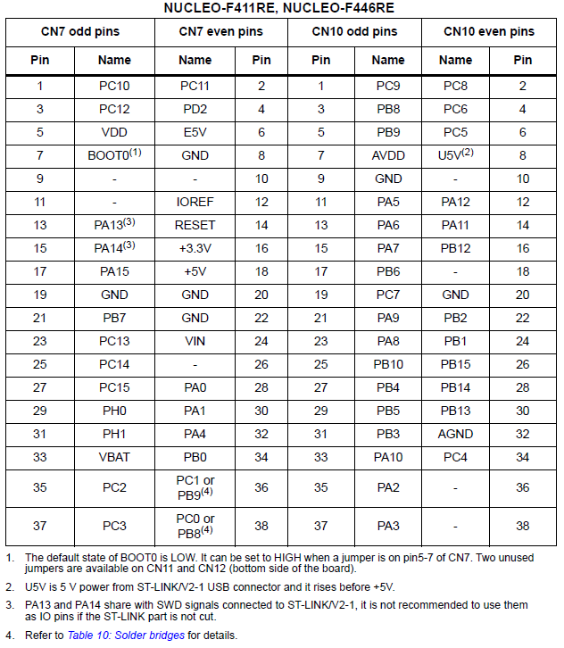
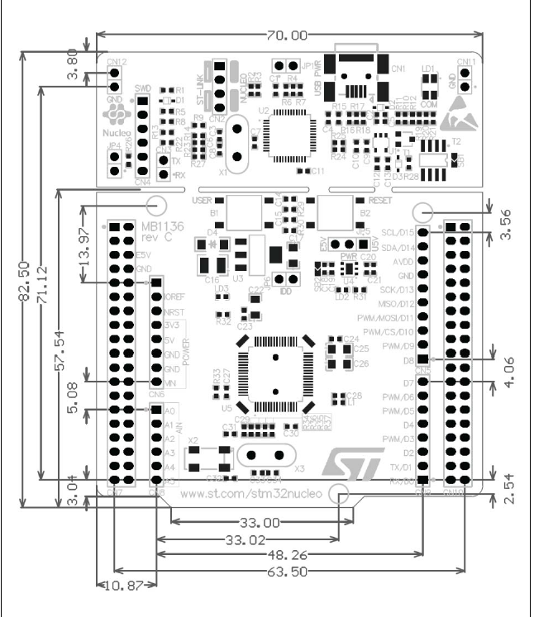
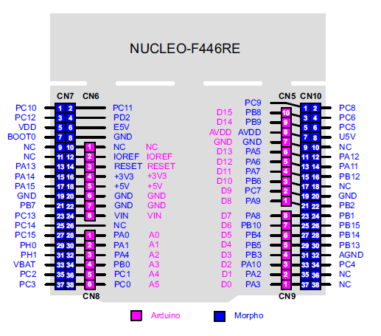
ⓒ MCU board (STM32F446RE)
Dimension
Notes:
SPI Port 확인 필요

Slide 12
ⓒ MCU board (STM32F446RE) – Connector Pin Descriptions
첨부 엑셀 자료 참조
12

Slide 13
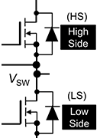
ⓕ LED Power Switch Module
LED Power Switch Module
VLED_1_SMPS
Driver
HIGH_1
VLED_1_LED
LOW_1
VLED_1_SMPS
LED ON/OFF MUX
HIGH_1
VLED_1
LED Module
HIGH_2
Driver
VLED_2
HIGH_3
HIGH_2
VLED_2_LED
VLED_3
LOW_1
LOW_2
LOW_2
VLED_1_SMPS
LOW_3
Driver
HIGH_3
VLED_3_LED
LOW_3

Slide 14
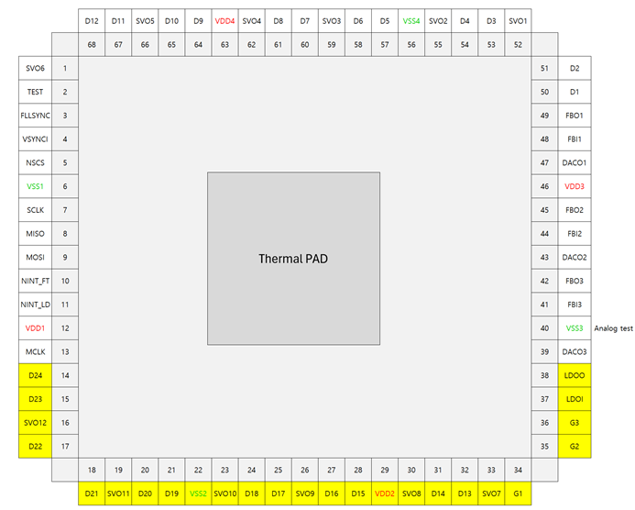
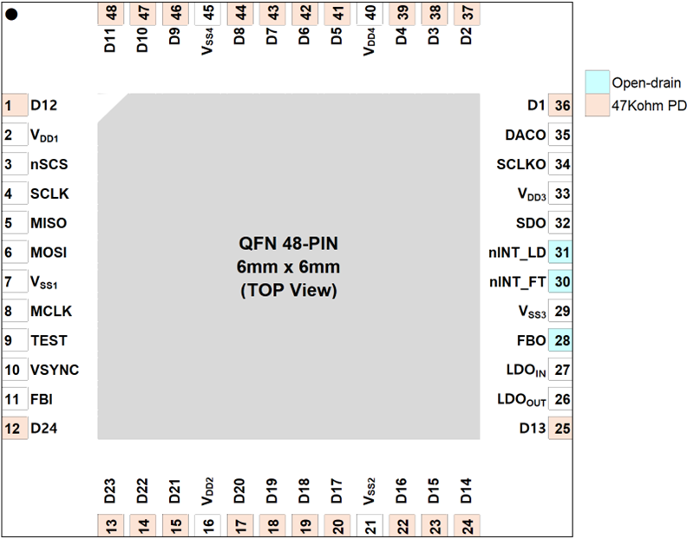
XC24 vs XC24R 칩 PIN out
XC24 (기존칩)
XC24R (New 칩)
QFN 68-PIN
8mm x 8mm
(TBD)
(TOP View)
참조용 칩임
(기존 칩)
Pin Assign
미확정

Slide 15
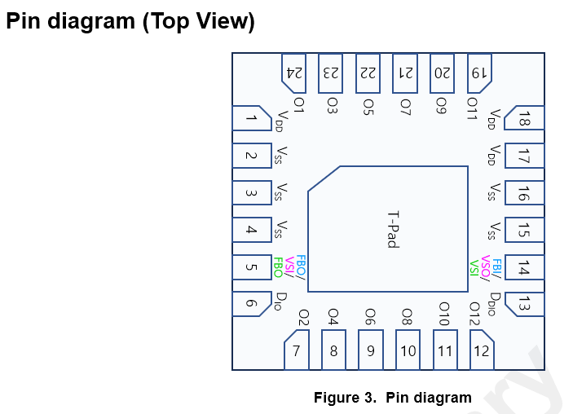
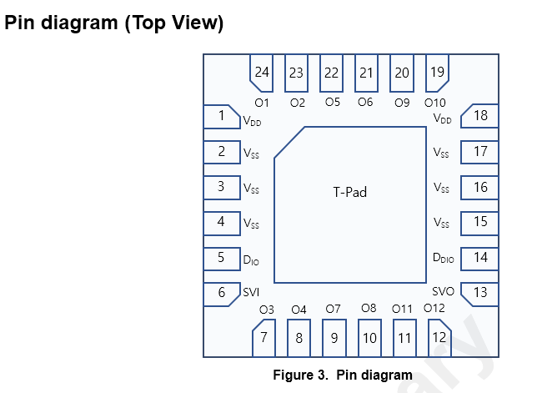
XD12P vs XD12R 칩 PIN out
XD12 (기존칩)
XD12R
(New 칩)
참조용 칩임
(기존 보드 칩)
Test pin
Test
주파수 출력
@
Trim
[XD12R New 칩 차이점 2가지]
1) 기존 칩의 Pin out에서 5, 6번 pin 위치가 서로 바뀜 (13,14 pin 도 swap)
(Data 신호선을 PKG 안쪽으로 배치해서 외부 노이즈 덜 받게 하기 위함)
2) 17번 pin이 Test mode 진입용 pin으로 지그 보드에서 MCU로 control 해야 함

Slide 16
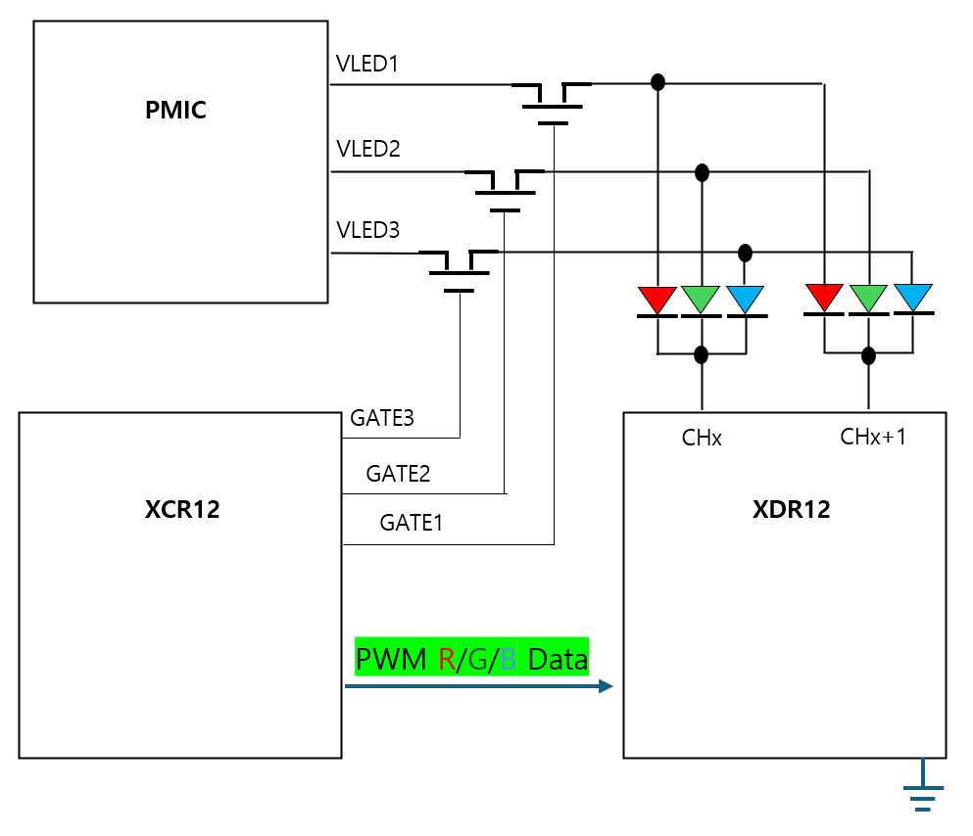
XCR-XDR 연결도
DACn
XCR 에 추가된 G1,G2,G3 는 VLED 를 on/off 하는
TR gate 를 control 하는 신호.
2. SVO1~12 는 XDR 에 연결되는 신호이며, 동일한
신호가 중복 출력하는 방식임. 여러 XDR이 공유 할
수도 있음.
3. DAC1~3 은 G1~3 에 대응하는 VLED 전압 조절신호.
XC24R
SVOn

Slide 17
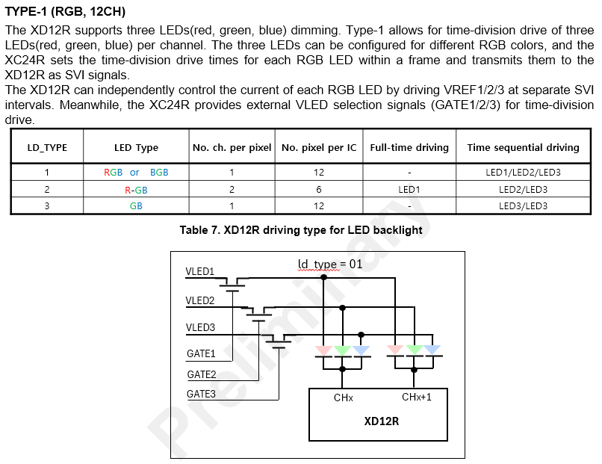
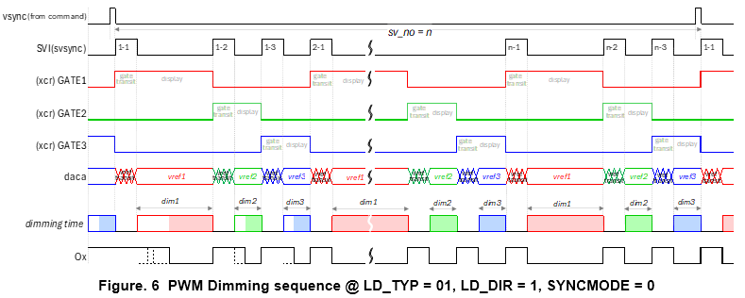
XD12R RGB PWM Dimming

Slide 18
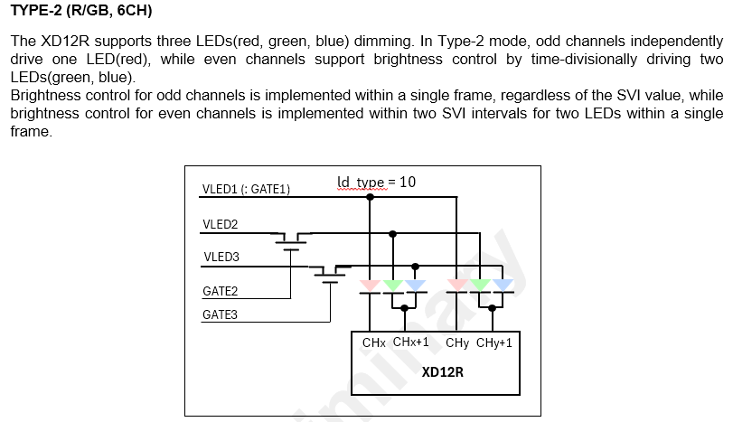
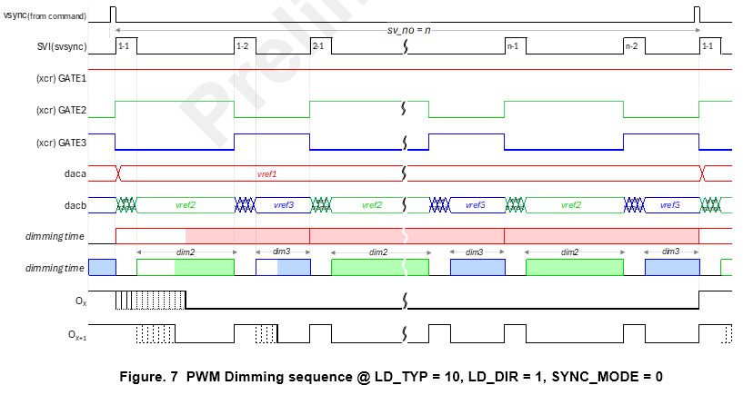
XD12R RGB PWM Dimming

Slide 19
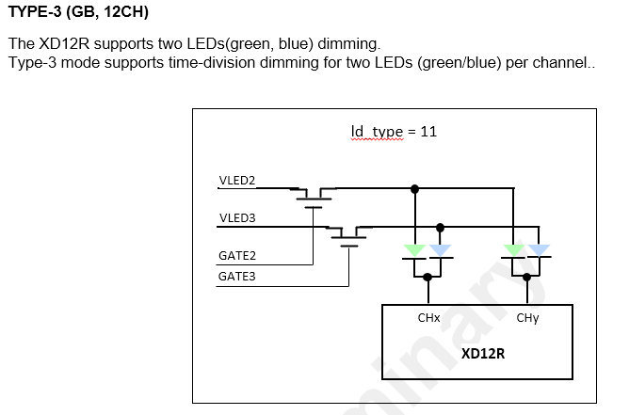
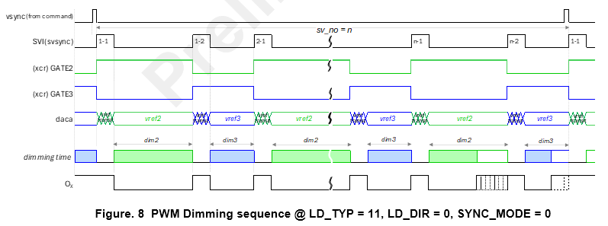
XD12R RGB PWM Dimming

Slide 20
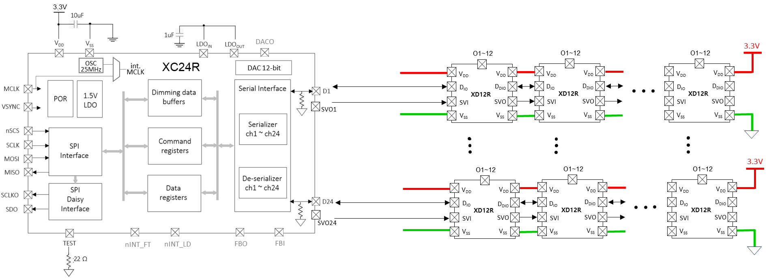
XCR-XDR Application Circuit 연결도

Slide 21
XD12R Pin out
24
23
22
21
20
19
1
O1
O2
O5
O6
O9
O10
18
V_{DD}
V_{DD}
2
V_{SS}
V_{SS}
17
3
V_{SS}
T-Pad
V_{SS}
16
4
V_{SS}
V_{SS}
15
5
D_{IO}
D_{DIO}
14
6
SVI
SVO
13
O3
O4
O7
O8
O11
O12
7
8
9
10
11
12
Figure 3. Pin diagram

Slide 22
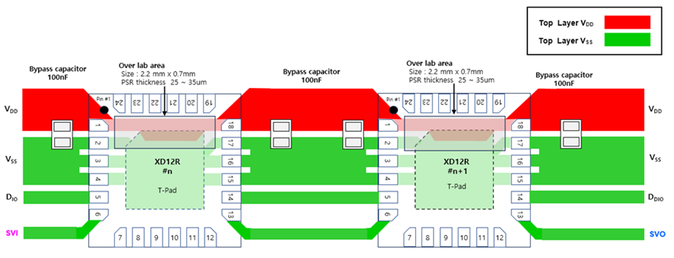
XD12R Layout for Power Lane for single-layer PCB

Slide 23
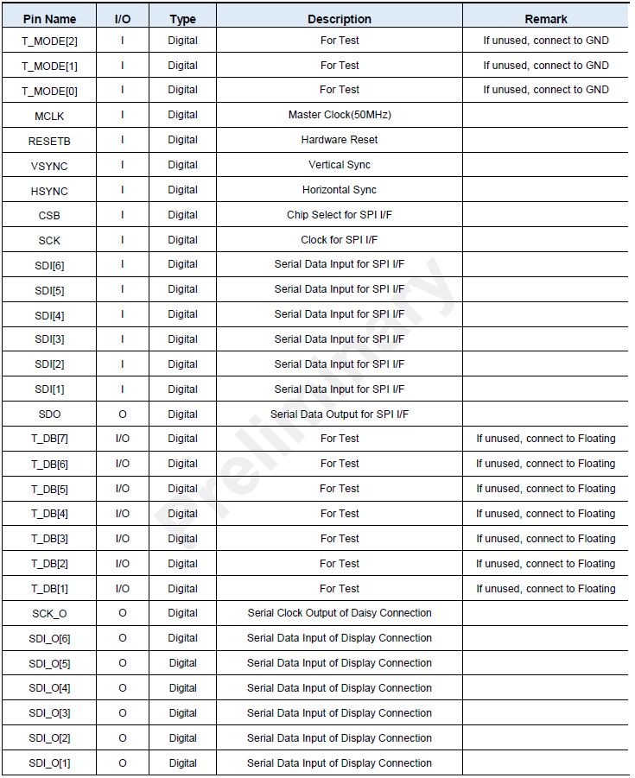
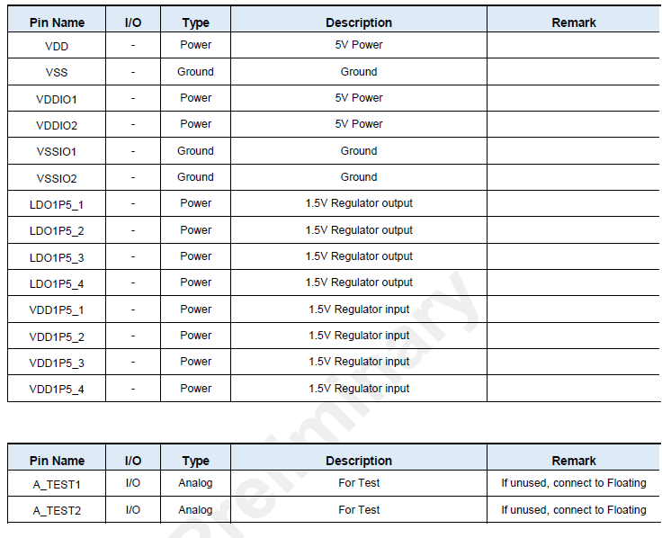
③ Display BLU Module
Connector Pin assign
TBD

Slide 24
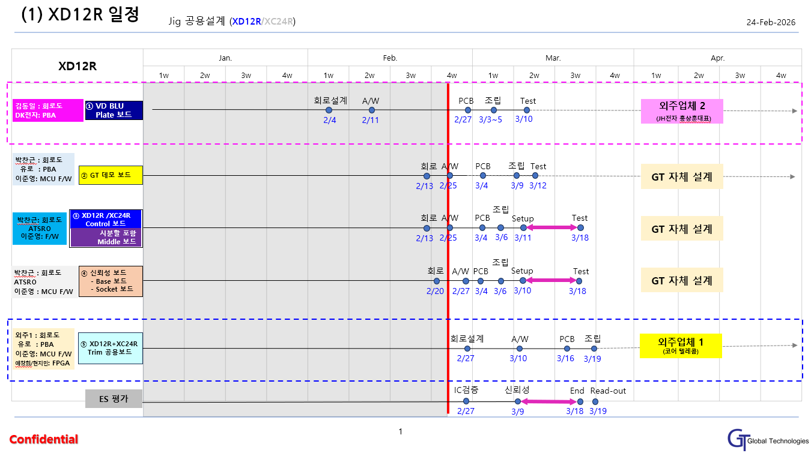
일정

Slide 25
XD12R Trimming을 위한 요청

Slide 26
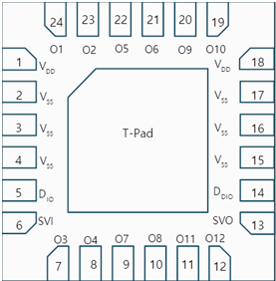
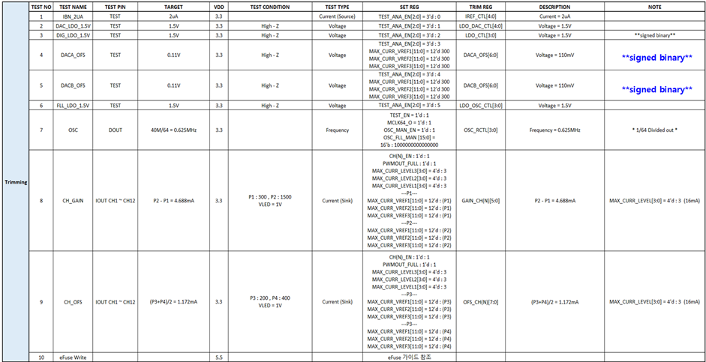
XD12R Trim을 위해 갖춰야 할 지그 H/W 요구사항
Update 2026.02.24
XD12R Trim을 위해 갖춰야 할 지그 H/W 요구사항. (이준영대리)
전원 VDD : 3.3V <-> 5.5V 선택 (Normal : 3.3V / eFuse : 5.5V) ; Trimming 시 5.5V 전원 입력해야 함.
Test (Pin 17): 전류 (1 ~ 10uA, Source) 및 전압 (0.1 ~ 1.5V) 측정 ; Jig보드내 ADC chip으로 전류 값 측정해야 합니다.
SVO (Pin 13): OSC 출력 (500 ~ 800kHz) 측정 ; Nucleo MCU로 주파수 센싱함, 센싱 pin 지정은 이준영대리 선정예정
O1 ~ 12 : Iout 전류(0 ~ 40mA->128mA, sink) ; XD04R용 Max 128 mA까지 전류 측정할 수 있게 회로 설계함
☞ Necleo MCU 기존 지그 프로그램 수정 최소화를 위해 Necleo 보드 커넥터 pin 선 지정 바람 (이준영대리 ~2/25)
전류 센싱 ADC 칩 IC Part number와 data sheet 공유바람 ; 이준영 대리, 박찬근

Slide 27
별 첨

Slide 28
System Block diagram
미확정
가안
Control JIG B’D
(XD12R + XC24R)
PC
MCU
Nucleo
Serial Out
Serial In
SVSYNC
XD12R
#1
Custom 제작 소켓 부품 실장 (1개)
(QFN 3030)
PC
상용 소켓 부품 실장 (2개)
(QFN 3030 → DIP 커넥터 type)
MCLK
VSYNC
FLL SYNC
SPIn
INTn
FPGA
Module
D1
SVO1
XD12R
#1
XD12R
#2
XD12R
#3
DAC
LED display (R,G,B chip)
GATEn
DACn
MUX
FET
Switching
;
Power
Supply
VLEDn
PMIC

